Slide 1
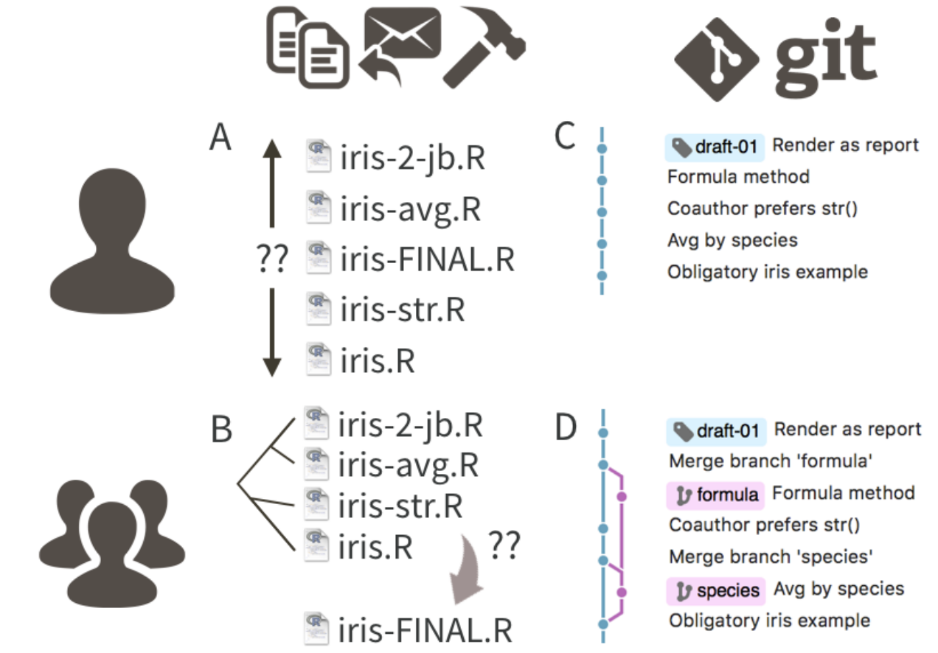
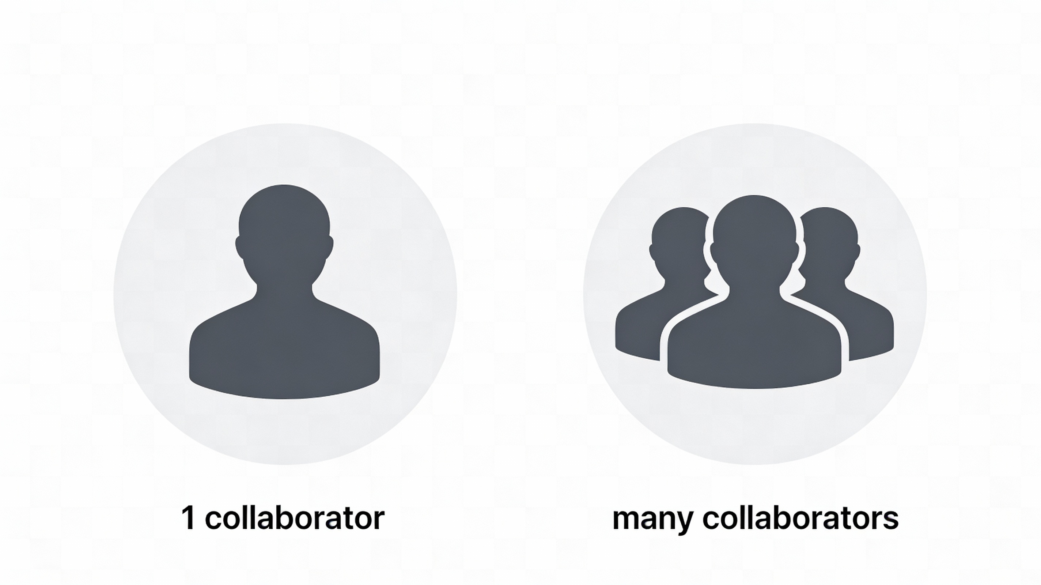

Slide 2


Slide 3









Slide 4
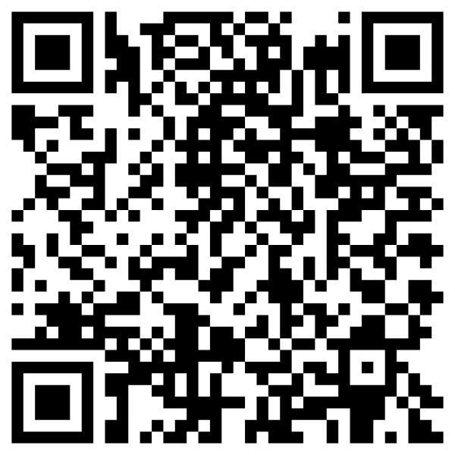

https://seredef.github.io/Github_course_final_final_v3_REALLYTHISONE/slides.html

Slide 5
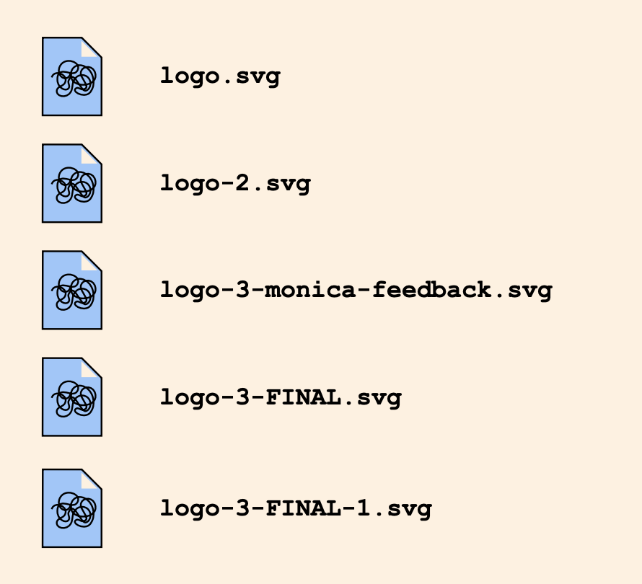
commit
commit
“Monica’s suggestion”

Slide 6
17-12-2025: deleted typo
377dfcd00dd057542b112cf13be6cf1380b

Slide 7
wild-experiment
main
better-analyses

Slide 8
wild-experiment
main
main
better-analyses

Slide 9


remote
me
not-me

Slide 10
remote
clone
me
clone
not-me

Slide 11
remote
me
Fixed a bug
not-me

Slide 12
remote
me
push
not-me

Slide 13
remote
pull
me
not-me

Slide 14
Your work
review
knowledge
Someone else’s work

